Slide 1
Chapter 7: Decision tree
Introduction of Decision tree
Decision tree model
ID3 algorithm
Random forest algorithm

Slide 2
7.1 Introduction of Decision tree
Decision tree is a kind of tree with decision rules (if then). It can predict the category or the value of test samples according to the decision rule of each node.
A simple example (dating) is used to illustrate the decision process of decision tree.

Slide 3
7.1 Introduction of Decision tree
A simple example of dating using decision tree:
Daughter: how old is he?
Mother: 26.
Daughter: how do you look?
Mother: Vvery handsome.
Daughter: how about the income?
Mother: Not very high, moderate.
Daughter: is it a civil servant?
Mother: Yes, he works in the Finance Burea.
Daughter: OK, I'll see you

Slide 4
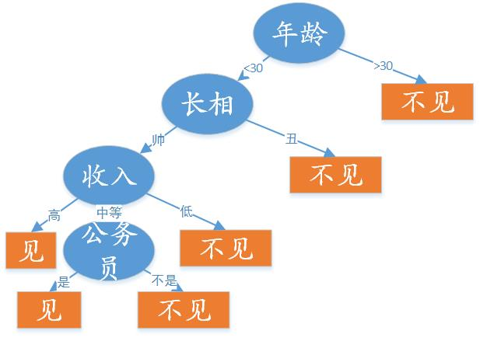
7.1 Introduction of Decision tree
This girl's decision-making process in deciding whether to date is a typical classification decision-making process, which is equivalent to deciding whether to date by age, appearance, income and whether to be a civil servant.
The decision-making process can be represented by the following decision tree:

Slide 5
Chapter 7: Decision tree
Introduction of Decision tree
Decision tree model
ID3 algorithm
Random forest algorithm

Slide 6
7.2 Decision tree model
Decision tree is a prediction model of attribute structure, which represents a mapping relationship between object attributes and object values.
It consists of node and directed edge, where there are two types of nodes: internal node and leaf node. Internal node represents a feature or attribute, and leaf node represents a class.

Slide 7
7.2 Decision tree model
It consists of node and directed edge, where there are two types of nodes: internal node and leaf node. Internal node represents a feature or attribute, and leaf node represents a class.
As in the example, the blue internal nodes represent the object attribute, the orange leaf nodes represent the classification results (whether to date or not), and the values on the directed edge indicate the possible values of each attribute or object feature.

Slide 8
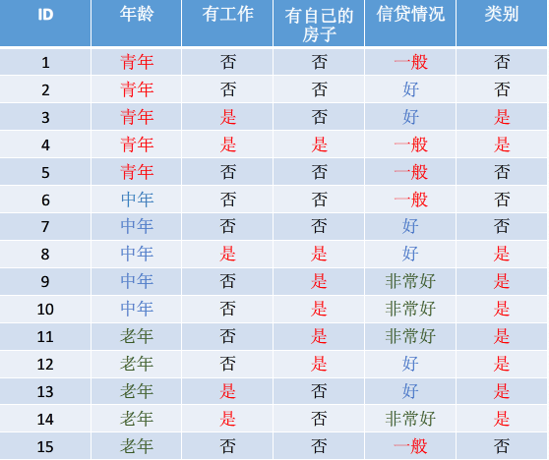
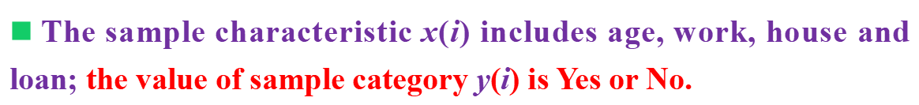
7.2 Decision tree model
The is a typical sample data set of loan application for decision tree classification.

Slide 9
7.2 Decision tree model
Decision tree model learning includes feature selection, decision tree generation and decision tree pruning. The decision tree generation corresponds to the local selection of the model parameters (local optimum) , and the decision tree pruning corresponds to the global selection of the model parameters (global optimum).
The common algorithms of decision tree are ID3, C4.5 and CART. Before introducing these algorithms, we will introduce several related concepts

Slide 10
7.2 Decision tree model
Information entropy
Information gain
Information gain ratio
Gini coefficient

Slide 11
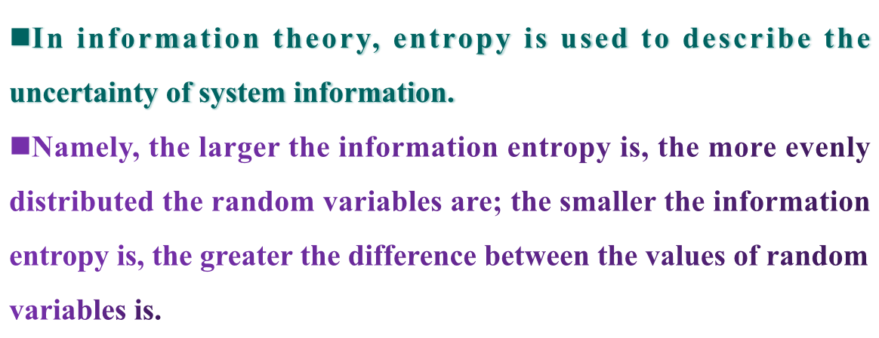
Information entropy

Slide 12
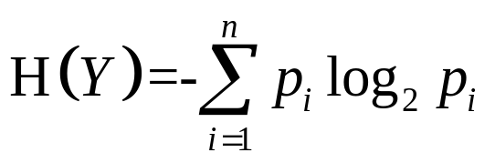
Information entropy
Let y be a discrete random variable with finite values, then the entropy of random variable y is defined as:
where n is the number of categories of samples, and P(i) is the probability of occurrence of each category i.

Slide 13
Information entropy
What is the information entropy of lending?

Slide 14
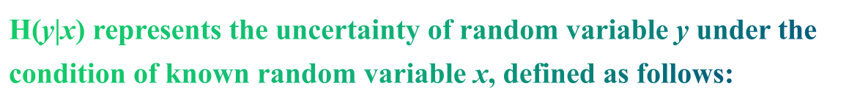
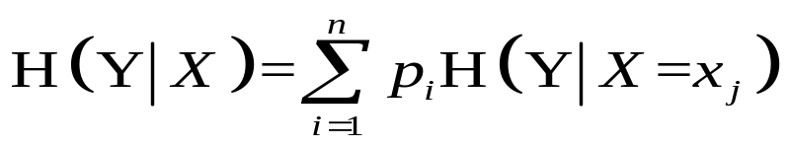
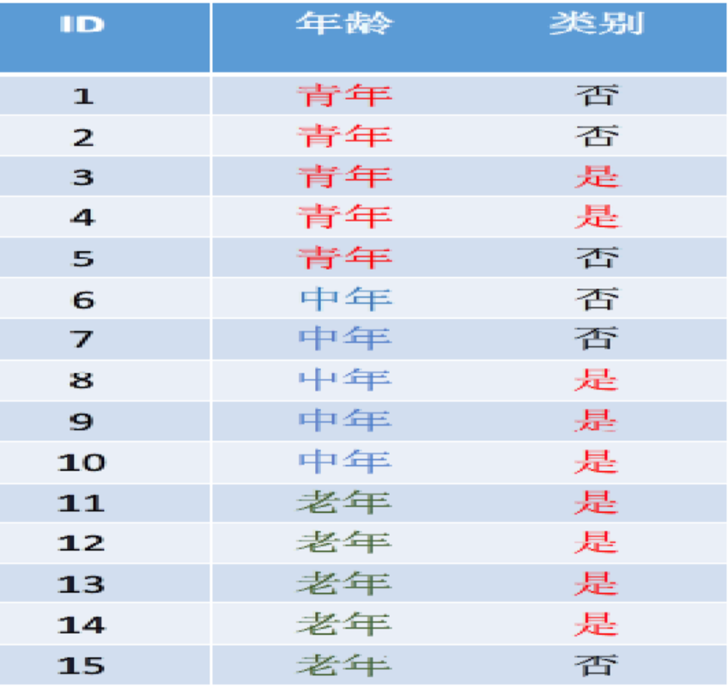
Conditional entropy
Calculating the conditional entropy when x is age.

Slide 15
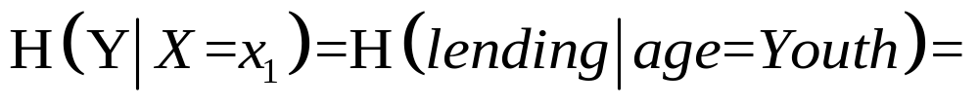
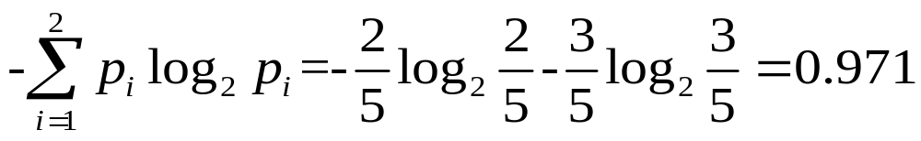
Firstly calculating the conditional entropy at different ages

Slide 16
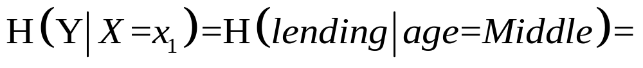
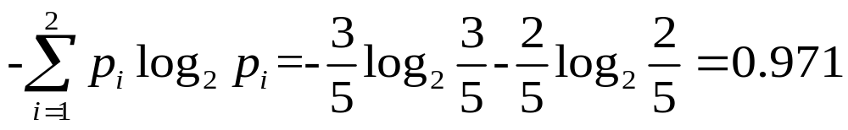
Firstly calculating the conditional entropy at different ages

Slide 17
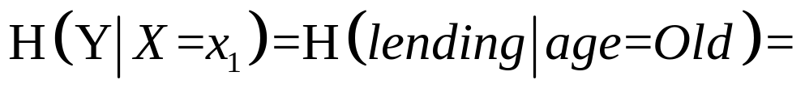
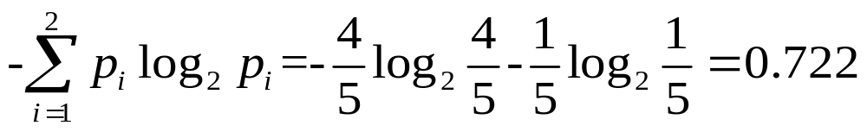
Firstly calculating the conditional entropy at different ages

Slide 18
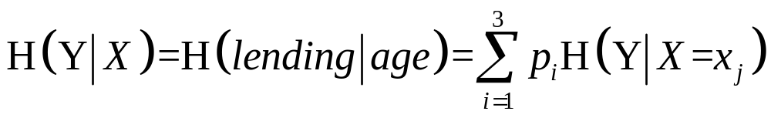
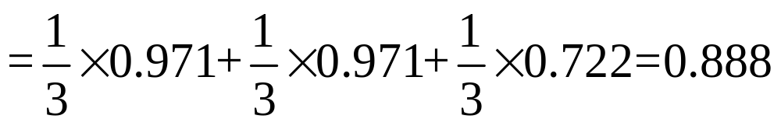
Finally calculating the conditional entropy at age

Slide 19
7.2 Decision tree model
Information entropy
Information gain
Information gain ratio
Gini coefficient

Slide 20
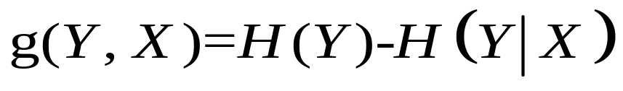
Information gain
Let y be a discrete random variable with finite features x, then the information gain of random variable y is defined as:
where H(y) is the entropy of y, and H(y|x) is the conditional entropy.

Slide 21
Information gain
What is the information gain of age?

Slide 22
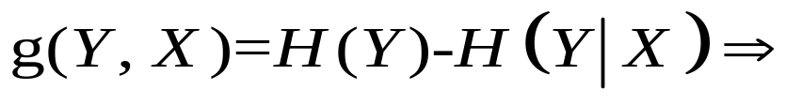
What is the information gain of age?

Slide 23
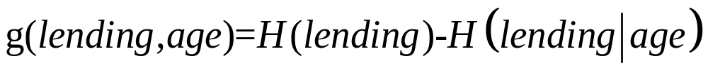


Slide 24
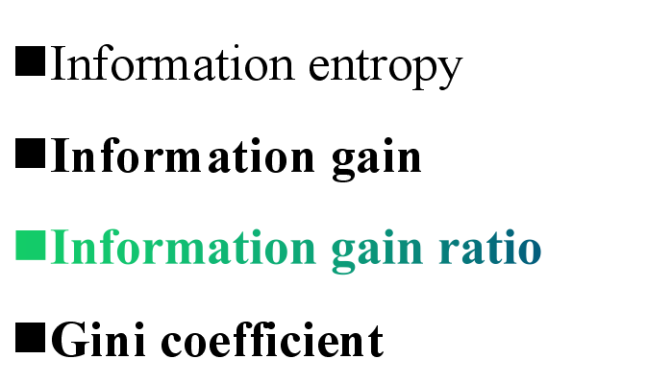
7.2 Decision tree model

Slide 25
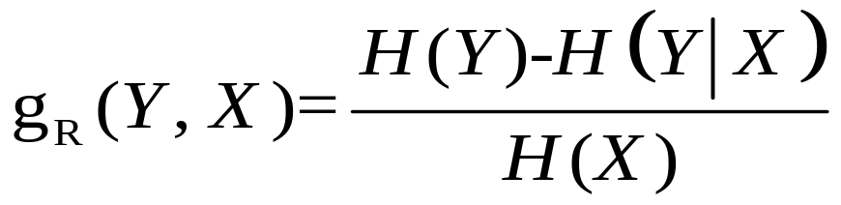
Information gain ratio
Let y be a discrete random variable with finite features x, then the information gain ratio of random variable y is defined as:
where H(y) is the entropy of y, and H(y|x) is the conditional entropy.

Slide 26
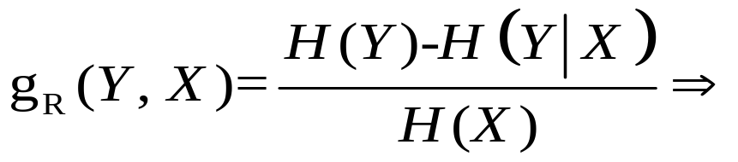
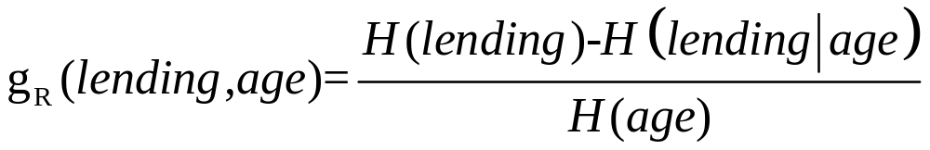
What is the information gain ratio of age?

Slide 27
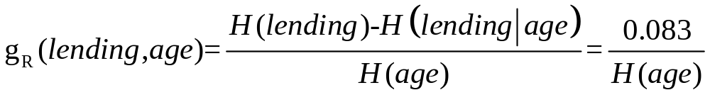

Slide 28
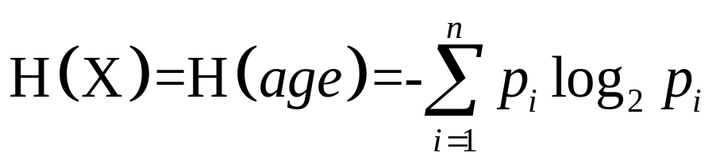
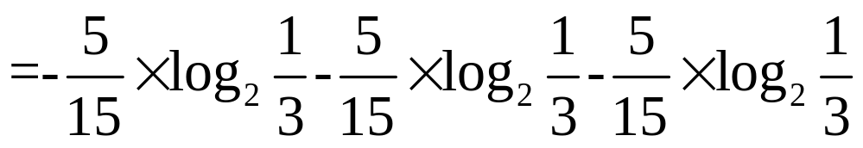

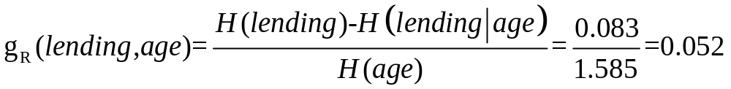

Slide 29
7.2 Decision tree model
Information entropy
Information gain
Information gain ratio
Gini coefficient

Slide 30
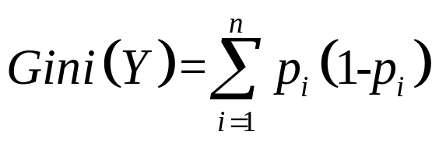
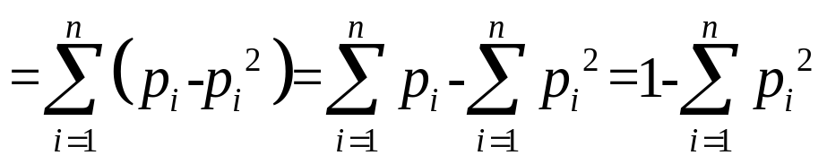
Gini coefficient
Let y be a discrete random variable with finite values, then the entropy of random variable y is defined as:
where n is the number of categories of samples, and P(i) is the probability of occurrence of each category i.

Slide 31
Gini coefficient
What is the Gini coefficient of lending?

Slide 32
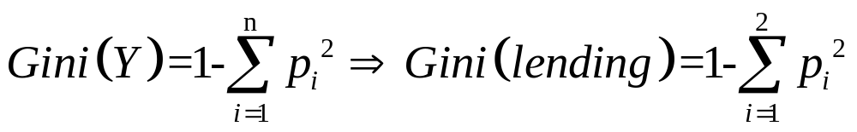
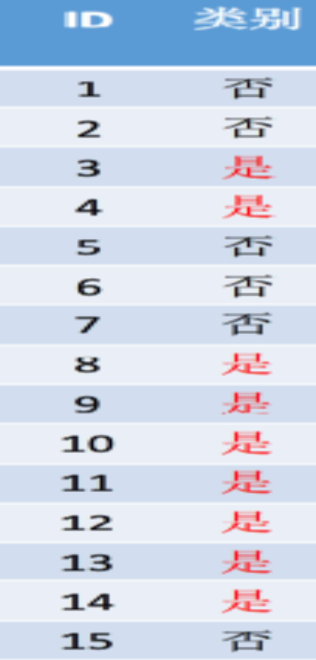
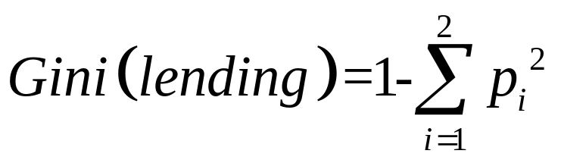
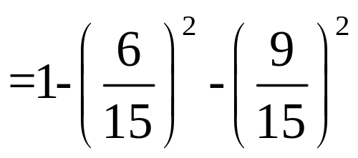

What is the Gini coefficient of lending?

Slide 33
Chapter 7: Decision tree
Introduction of Decision tree
Decision tree model
ID3 algorithm
Random forest algorithm

Slide 34
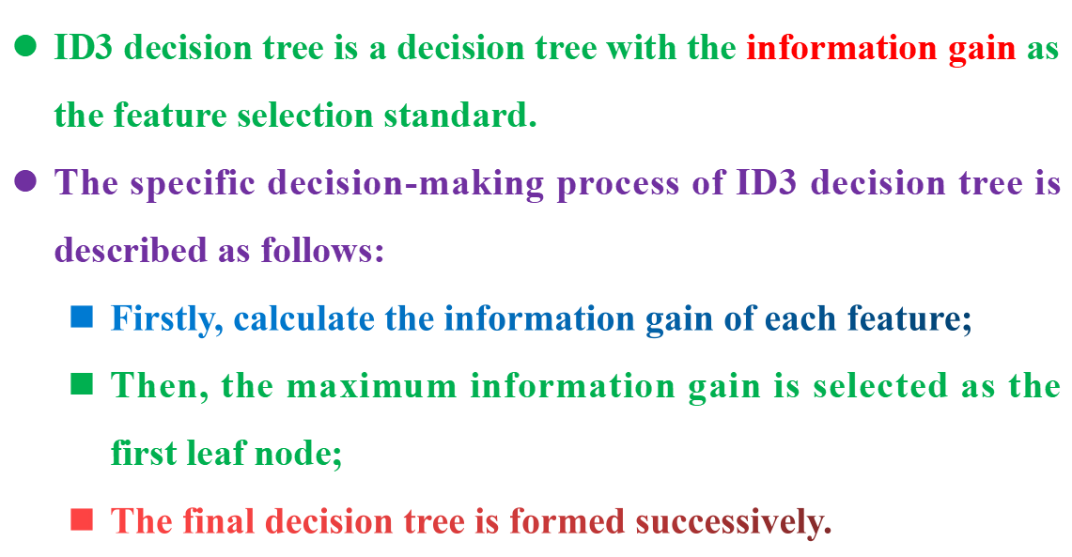
ID3 algorithm

Slide 35
Firstly, calculate the information gain of each feature

Slide 36
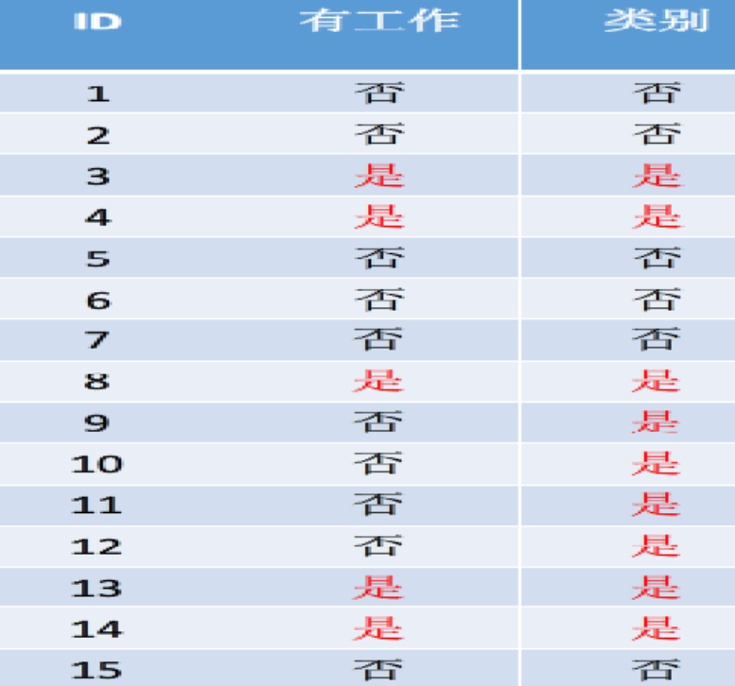
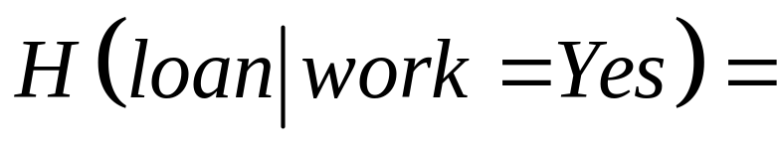
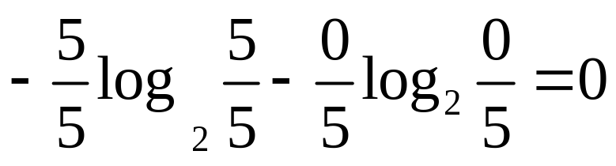

Slide 37
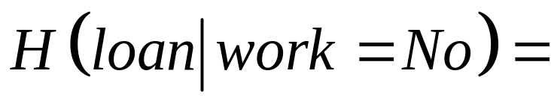
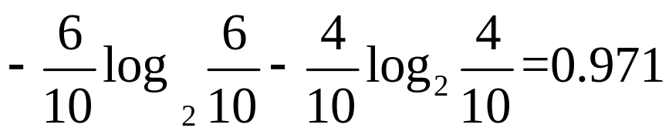

Slide 38
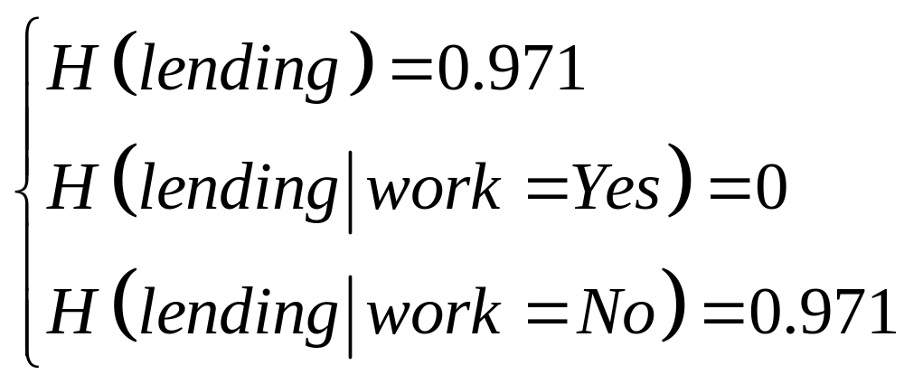
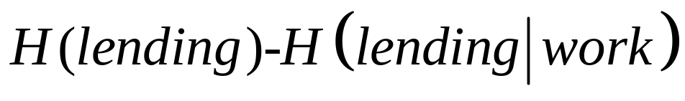
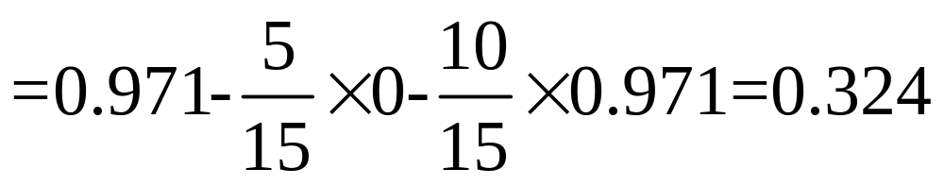

Slide 39
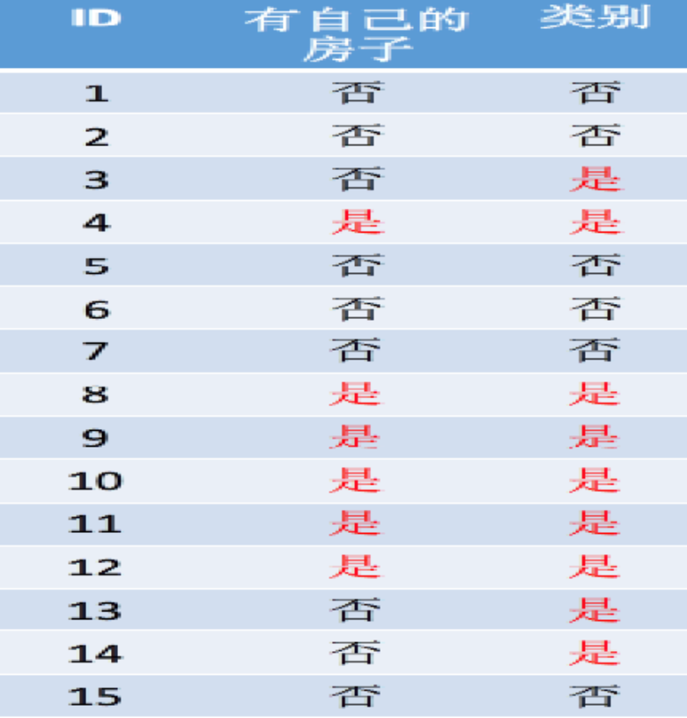
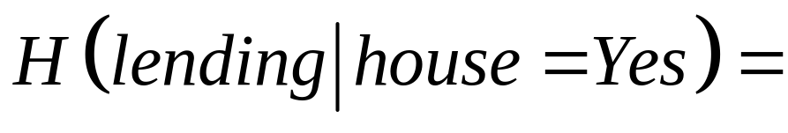
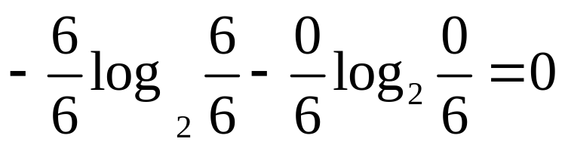

Slide 40
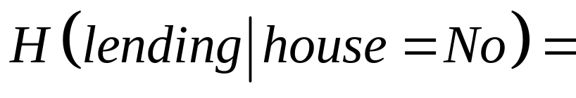
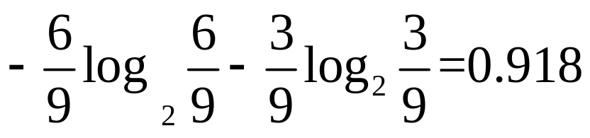

Slide 41
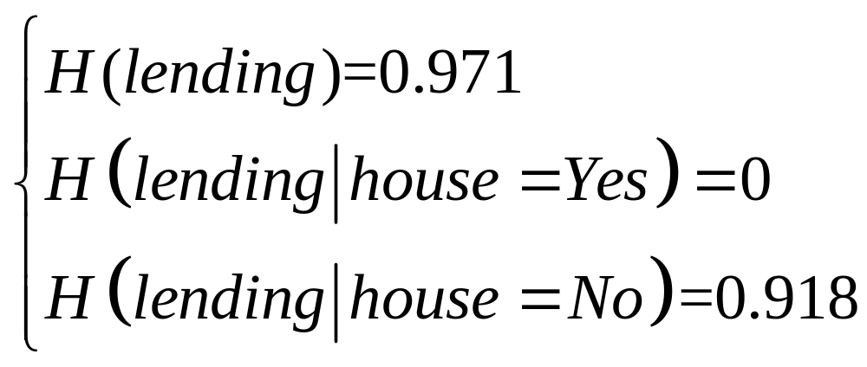
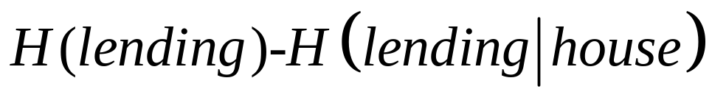
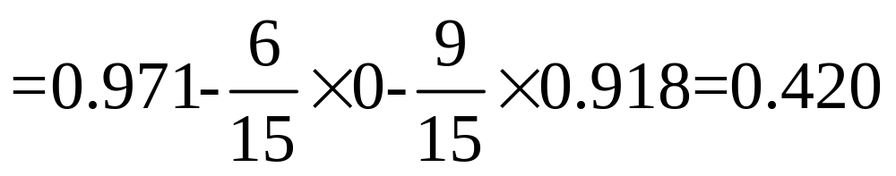

Slide 42




Slide 43



Slide 44



Slide 45




Slide 46


Secondly, Select the maximum information gain as the first leaf node

Slide 47

Secondly, Select the maximum information gain as the first leaf node

Slide 48

The final decision tree of ID3 algorithm is:

Slide 49

C4.5 algorithm

Slide 50



Slide 51




Firstly, calculate the information gain ratio of each feature

Slide 52






Slide 53






Slide 54






Slide 55


C4.5 algorithm

Slide 56



Slide 57

CART algorithm

Slide 58


CART algorithm

Slide 59
Firstly, calculate the Gini coefficient of each feature

Slide 60

Calculation of Gini coefficient at age

Slide 61

Calculation of Gini coefficient at age

Slide 62

Calculation of Gini coefficient at age

Slide 63

Calculation of Gini coefficient at age

Slide 64



Calculation of Gini coefficient at age

Slide 65

Calculation of Gini coefficient at work

Slide 66





Slide 67

Calculation of Gini coefficient at house

Slide 68





Slide 69

Calculation of Gini coefficient at credite

Slide 70




Slide 71




Slide 72


Slide 74
Chapter 7: Decision tree
Introduction of Decision tree
Decision tree model
ID3 algorithm
Random forest algorithm

